Slide 1
SIG AI
<welcome to>
Meeting 3: 04/04/24

Slide 3
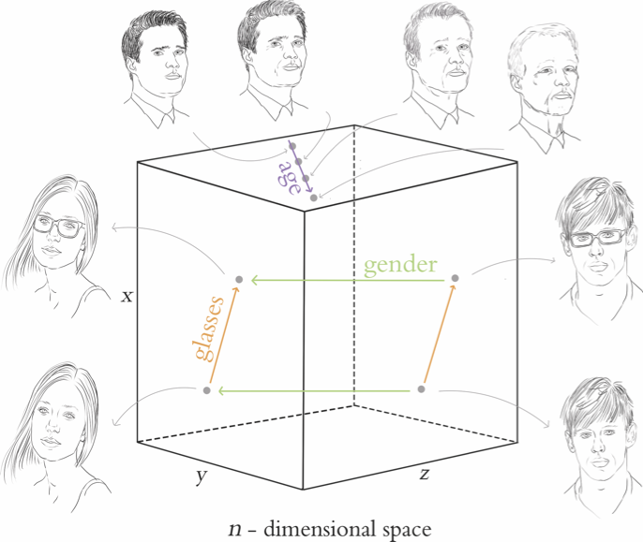

Slide 4
(ooga booga) What is Deep Learning?
Deep learning is a subset of machine learning that uses multi-layered neural networks, called deep neural networks, to simulate the complex decision-making power of the human brain. Some form of deep learning powers most of the artificial intelligence (AI) in our lives today.
By strict definition, a deep neural network, or DNN, is a neural network with three or more layers. In practice, most DNNs have many more layers. DNNs are trained on large amounts of data to identify and classify phenomena, recognize patterns and relationships, evaluate possibilities, and make predictions and decisions.
While a single-layer neural network can make useful, approximate predictions and decisions, the additional layers in a deep neural network help refine and optimize those outcomes for greater accuracy.
Notes:
Come back to this after teaching ‘Perceptron’, and a ‘neural network’

Slide 5
What use-case can you think of, where using unlabelled data might be beneficial, with more than just input-compute-output?
Notes:
Removing/Identifying duplicates

Slide 6

Notes:
I know we keep bringing classification problems into every kind of algorithm, but you need to understand most algorithm differ in accuracy, architecture and size of dataset they can handle, and NOT the problems they solve.

Slide 7
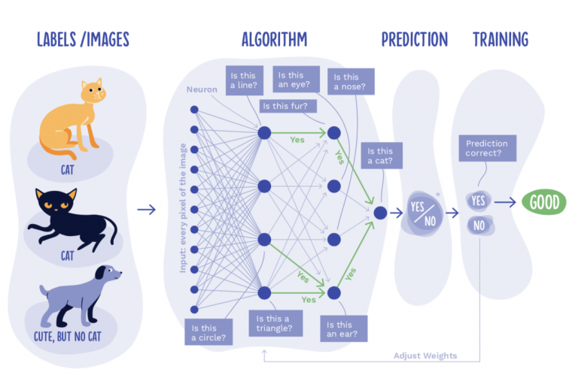

Slide 8


Is this a cat or a dog?
Notes:
Sounds like an easy problem, but for a ‘machine learning’ algorithm- this is extremely difficult. Everything thing it has been trained on, cats and pointy ears; dogs and big doe eyes- is falling out the window. How do you help your ML algorithm, when it has to generalise to such exceptions? Or, maybe, it has to be used for use cases beyond identification- and an incorrect identification could lead to incorrect medical analysis etc?
MORE LAYERS!!

Slide 9
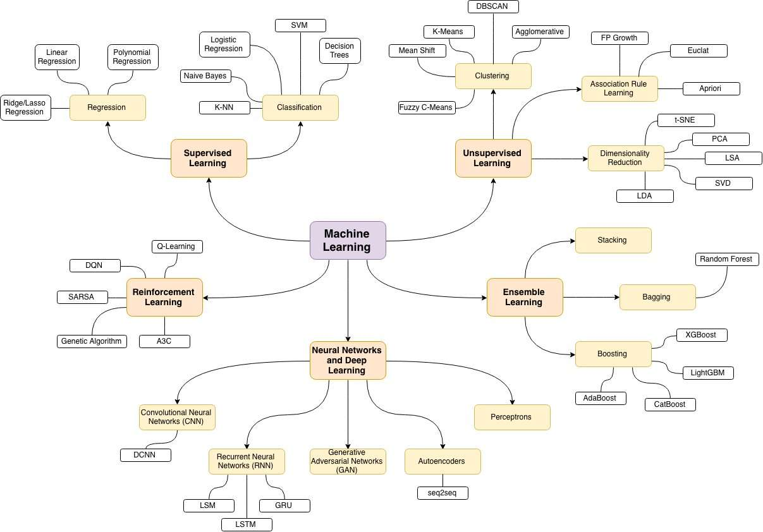

TODAY
Notes:
Ok, what are the different types?

Slide 10
What are we tackling today?
Machine Learning
- Deep Learning
-Perceptrons
-Autoencoders

Slide 11
Ok, what are the different types?
Perceptrons
Autoencoders
Convolution Neural Networks
(CNNs)
Generative Adversarial Networks (GANs)
Recurrent Neural Networks
(RNNs)

Slide 12
Ok, what are the different types?
Perceptrons
Autoencoders
The basis of the idea of the perceptron is rooted in the words perception (the ability to sense something) and neurons (nerve cells in the human brain that turn sensory input into meaningful information).
PCA
PCA is a dimensionality reduction technique that is often used to reduce the dimensionality of large data sets, by transforming a large set of variables into a smaller one that still contains most of the information in the large set.

Slide 13
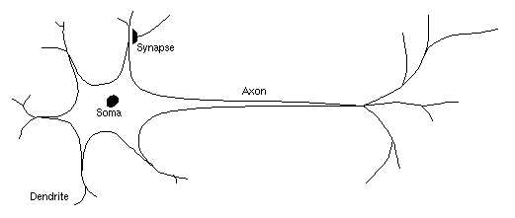
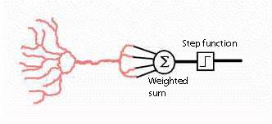
Perceptrons
Perceptrons are the building blocks of neural networks. They are artificial models of biological neurons that simulate the task of decision-making. Perceptrons aim to solve binary classification problems given their input.
Lore of perceptrons and biological neurons
Notes:
Biological neuron only fires when stimulus reaches a certain threshold. Perceptrons use the ‘step function’ for the same.
The input vector
All the input values of each perceptron are collectively called the input vector of that perceptron.
The weight vector
Similarly, all the weight values of each perceptron are collectively called the weight vector of that perceptron.

Slide 14
Notes:
Let’s say, shape of face is layer 1, facial features (eyes, nose, etc) is layer 2.
As mentioned above, a perceptron calculates the weighted sum of the input values. For simplicity, let us assume that there are two input values, x and y for a certain perceptron P. Let the weights for x and y be A and B for respectively, the weighted sum could be represented as: A x + B y.
Since the perceptron outputs an non-zero value only when the weighted sum exceeds a certain threshold C, one can write down the output of this perceptron as follows:
Output of P =
{1 if A x + B y > C
{0 if A x + B y < = C

Slide 15

Notes:
Let’s say, shape of face is layer 1, facial features (eyes, nose, etc) is layer 2.
As mentioned above, a perceptron calculates the weighted sum of the input values. For simplicity, let us assume that there are two input values, x and y for a certain perceptron P. Let the weights for x and y be A and B for respectively, the weighted sum could be represented as: A x + B y.
Since the perceptron outputs an non-zero value only when the weighted sum exceeds a certain threshold C, one can write down the output of this perceptron as follows:
Output of P =
{1 if A x + B y > C
{0 if A x + B y < = C

Slide 16
Perceptron Main Components
Perceptrons use three main components for classification:
Input: Numerical input values correspond to features. i.e. [22, 130] could represent a person’s age & weight features.
Weights: Each feature has a weight assigned; this determines the feature’s importance. i.e. In a class, homework might be weighted 30%, but a final exam 50%. Therefore the final is more important to the overall grade (output).
Output: This is computed using inputs and weights. Output is either binary (1,0) or a value in a continuous range (70-90).
Notes:
Let’s say, shape of face is layer 1, facial features (eyes, nose, etc) is layer 2.
As mentioned above, a perceptron calculates the weighted sum of the input values. For simplicity, let us assume that there are two input values, x and y for a certain perceptron P. Let the weights for x and y be A and B for respectively, the weighted sum could be represented as: A x + B y.
Since the perceptron outputs an non-zero value only when the weighted sum exceeds a certain threshold C, one can write down the output of this perceptron as follows:
Output of P =
{1 if A x + B y > C
{0 if A x + B y < = C

Slide 17
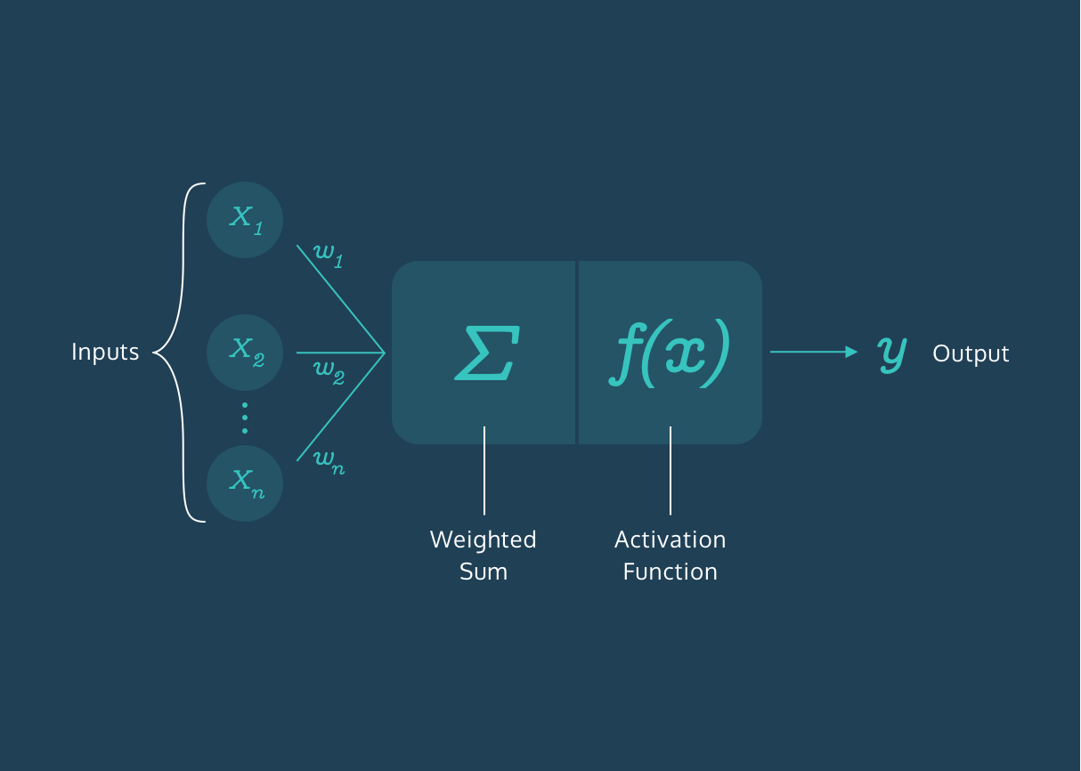
Perceptron: Weights
Notes:
Can be loosely called as ‘Intensity of each input’
How round is the face? How sure are we that something IS a nose/ ear?
Truthness/ Dependability of a given input value w.r.t what it is representing.

Slide 18
Perceptron: Weights
The first step in the perceptron classification process is calculating the weighted sum of the perceptron’s inputs and weights.
To do this, multiply each input value by its respective weight and then add all of these products together. This sum gives an appropriate representation of the inputs based on their importance.
inputs = [x1, x2, x3]
weights = [w1, w2, w3]
weighted_sum = x1*w1 + x2*w2 + x3*w3

Slide 19
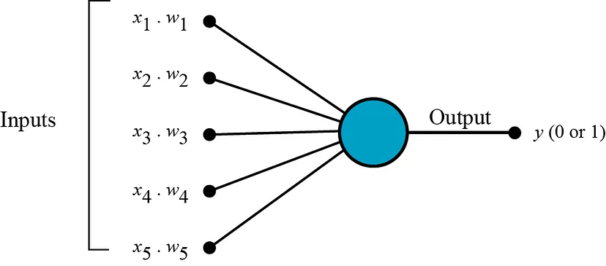
Perceptron: Weights
Notes:
Can be loosely called as ‘Intensity of each input’
How round is the face? How sure are we that something IS a nose/ ear?
Truthness/ Dependability of a given input value w.r.t what it is representing.

Slide 20
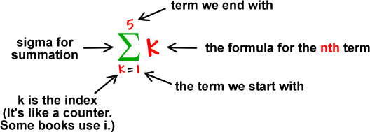
Perceptron: Weighted Sum
Notes:
Can be loosely called as ‘Intensity of each input’
How round is the face? How sure are we that something IS a nose/ ear?
Truthness/ Dependability of a given input value w.r.t what it is representing.

Slide 21
Perceptron: Optimisation Weights
The expression error * input computes the adjustment to be made to the weight. If the perceptron correctly classified the example, the error is 0 and the weight is not adjusted. If the perceptron misclassified the example, the error is non-zero and the weight is adjusted proportionally to the value of error * input.
The weights are adjusted in the direction that reduces the error.
The updated weight is then given by weight = weight + (error * input). This process is repeated for each training example, which gradually adjusts the weights to minimize the error on the training examples. This is known as gradient descent.
In summary, the goal of optimizing perceptron weights is to find the best set of weights that minimizes the error on the training data, thereby increasing the accuracy of the perceptron’s classifications. This is a fundamental concept in machine learning and forms the basis for many more complex algorithms and models.
Notes:
In a neural network, the weighted sum is calculated as the first step in generating a prediction. Each input is multiplied by its corresponding weight, and these products are then summed together. This weighted sum is then passed through an activation function to produce the final output or prediction.
The difference between this prediction and the actual value (the error) is then used to adjust the weights.
The goal is to minimize this error, and thus improve the accuracy of the model. This is where optimization comes in.
The weights are adjusted in the direction that reduces the error. This is typically done using a method called gradient descent. The gradient (or derivative) of the error with respect to the weights indicates the direction of steepest ascent - i.e., the direction in which the error increases the most. By subtracting this gradient from the weights, we move the weights in the direction of steepest descent, which is the direction that reduces the error the most.

Slide 22
Why are we ‘optimising weights’ AFTER calculating the weighted sum?
Shouldn’t we take into account the error per input, BEFORE we add it all?
Notes:
In a neural network, the weighted sum is calculated as the first step in generating a prediction. Each input is multiplied by its corresponding weight, and these products are then summed together. This weighted sum is then passed through an activation function to produce the final output or prediction.
The difference between this prediction and the actual value (the error) is then used to adjust the weights.
The goal is to minimize this error, and thus improve the accuracy of the model. This is where optimization comes in.
The weights are adjusted in the direction that reduces the error. This is typically done using a method called gradient descent. The gradient (or derivative) of the error with respect to the weights indicates the direction of steepest ascent - i.e., the direction in which the error increases the most. By subtracting this gradient from the weights, we move the weights in the direction of steepest descent, which is the direction that reduces the error the most.
This process of calculating the weighted sum, making a prediction, calculating the error, and adjusting the weights is repeated many times over the course of the training process. Each repetition is known as an iteration, and the entire process is an example of iterative optimization.
the weighted sum is used to make a prediction, and the accuracy of this prediction (as measured by the error) is what we’re trying to improve by optimizing the weights

Slide 23
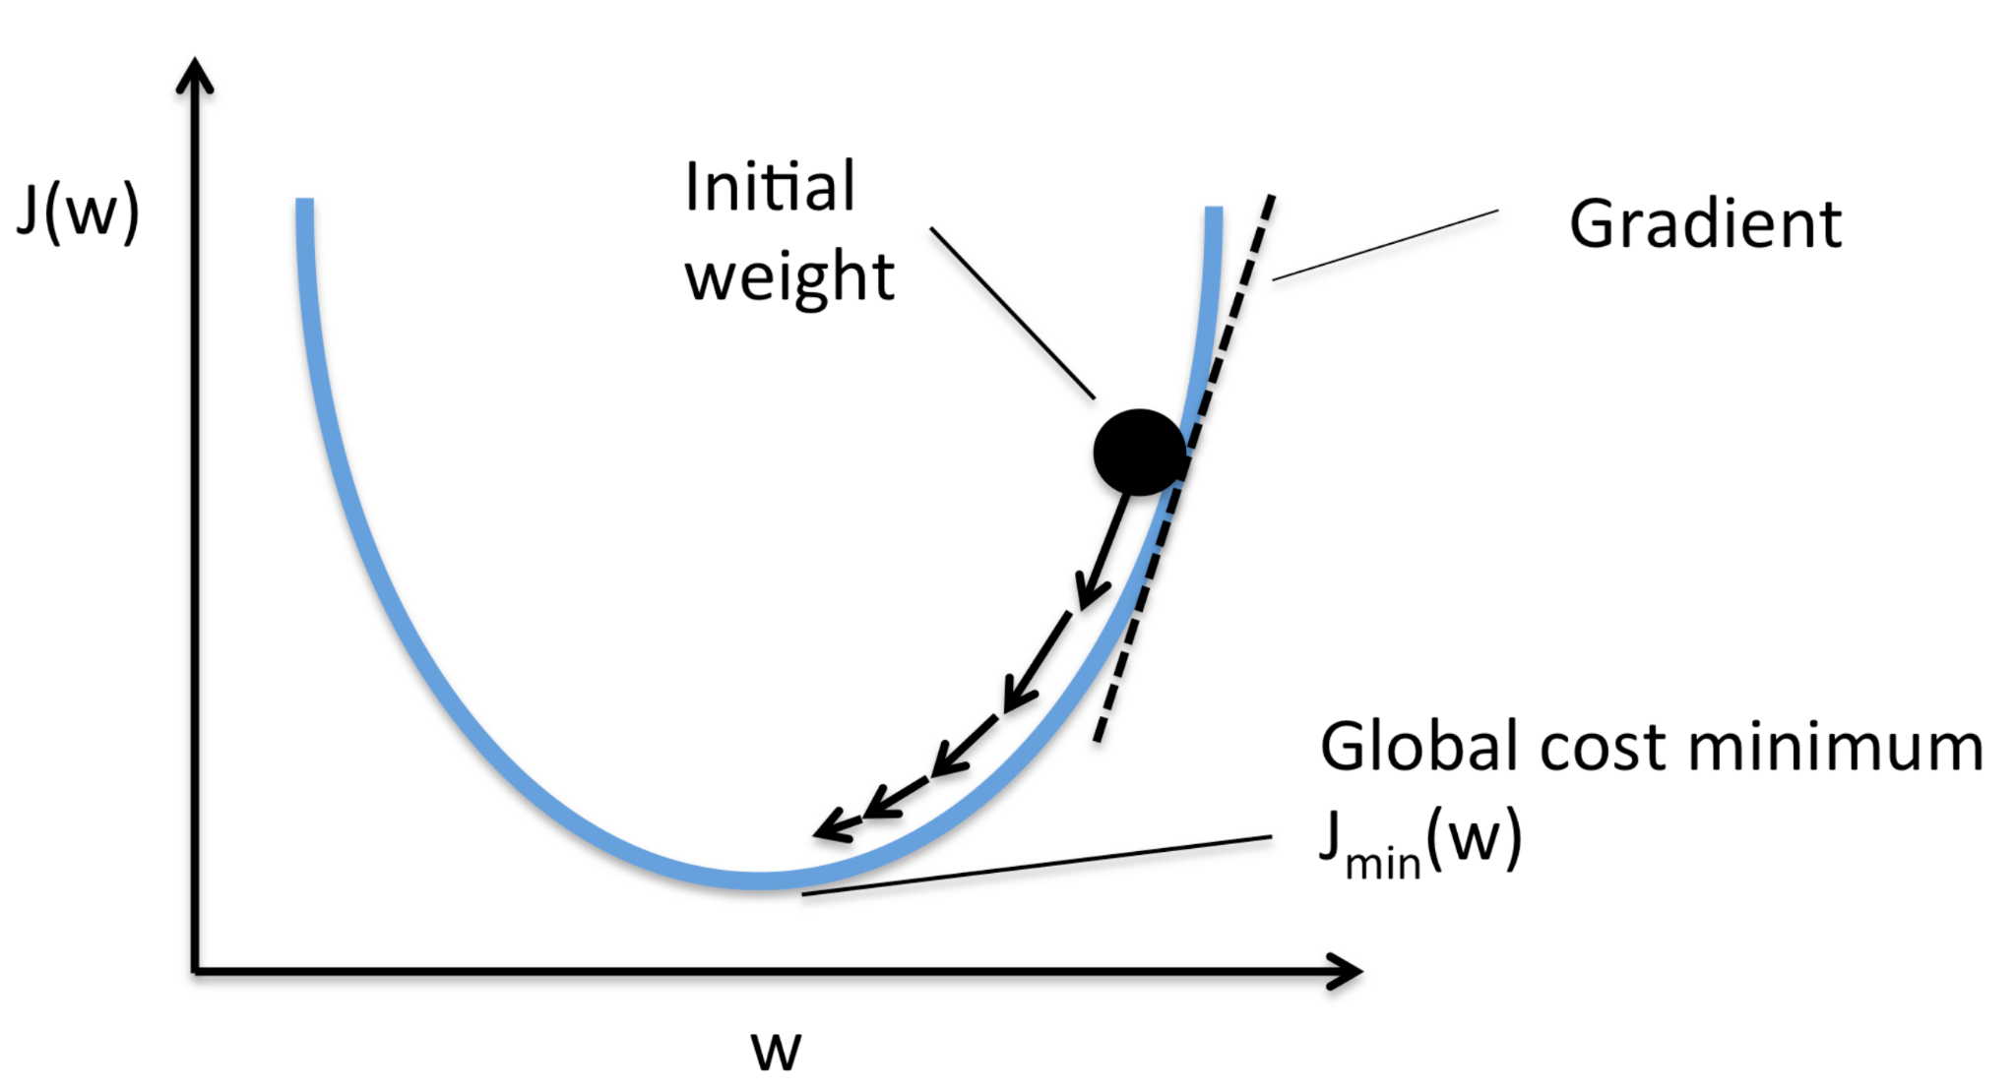
Notes:
Interactive

Slide 24
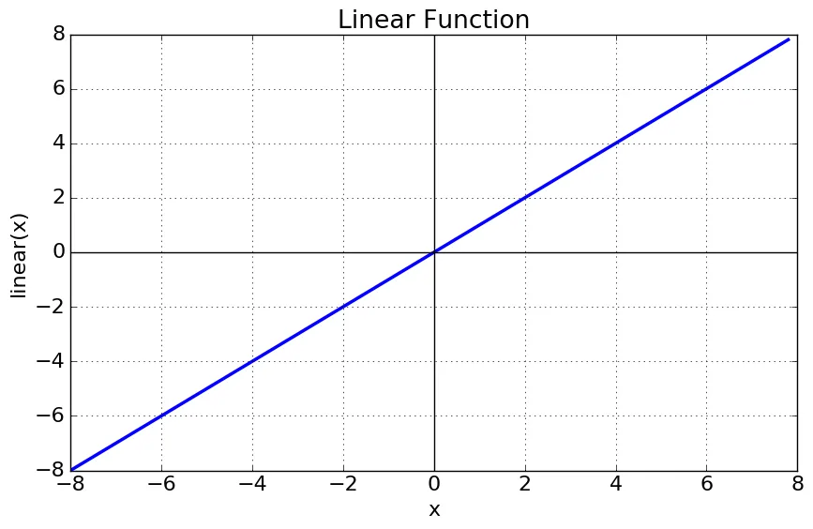
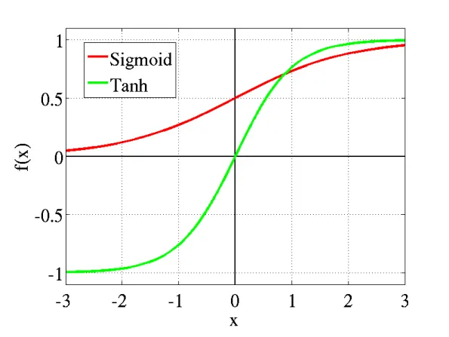

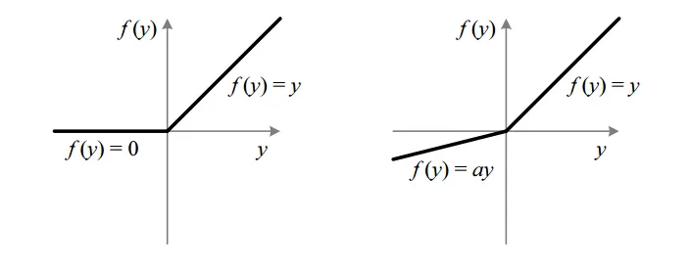
Perceptron: Activation Sum
It is used to determine the output of neural network like yes or no. It maps the resulting values in between 0 to 1 or -1 to 1 etc. (depending upon the function).
Notes:
It’s like saying I want it to give me binary values/ clean definite answers- I need a line on a plane, that cleanly separates it for the same.
One of these special functions is applied to the weighted sum of inputs and weights to constrain perceptron output to a value in a certain range, depending on the problem.
Some example ranges are [0,1], [-1,1], [0,100].

Slide 25
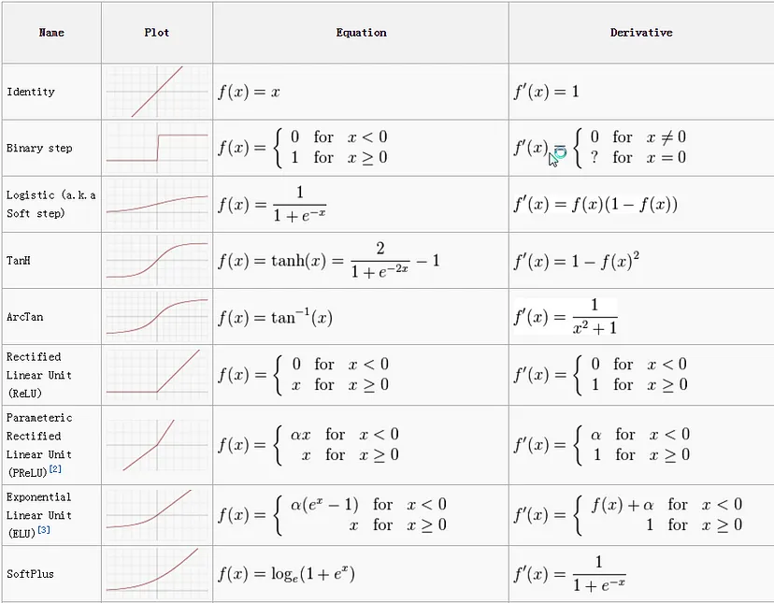

Slide 26
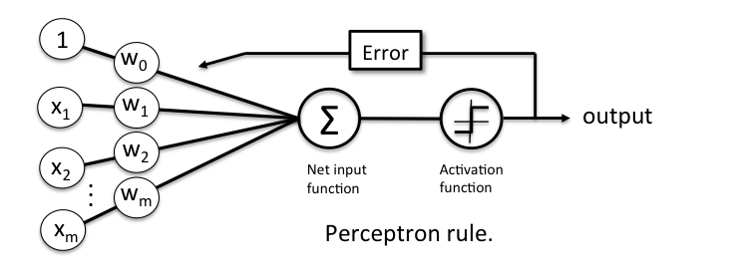

Slide 27


Perceptron: Differentiation?

Slide 28
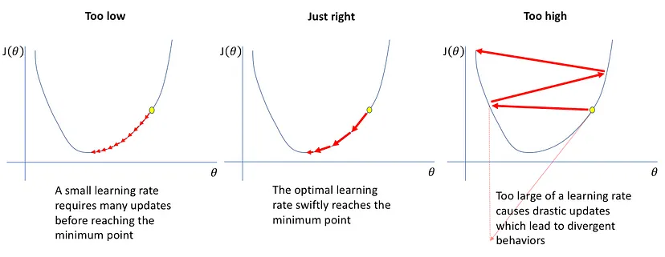
Perceptron: Differentiation?
When updating the curve, to know in which direction and how much to change or update the curve depending upon the slope.
Notes:
Imagine you’re on a hill and you want to get to the bottom. But, it’s really foggy and you can’t see the bottom. So, what do you do? You might feel the ground with your feet to figure out which way is downhill and start walking in that direction.
This is similar to what we’re doing with gradient descent. The “hill” is our error: we want to reduce it, or get it to the “bottom”. The “fog” is because we don’t know ahead of time what the best weights are to minimize the error.
So, we calculate the gradient, which tells us the direction of steepest ascent - or which way is “uphill”.
But we want to go downhill, so we go in the opposite direction - we subtract the gradient from our weights.
We take small steps (determined by a parameter called the learning rate) to ensure we don’t overshoot the bottom. We keep doing this until we get to the bottom of the hill, or in other words, until our error is as small as we can get it.
Don’t take LARGE steps or you’ll be running around with no real progress.
CONS: getting stuck in local minima!!!!

Slide 29
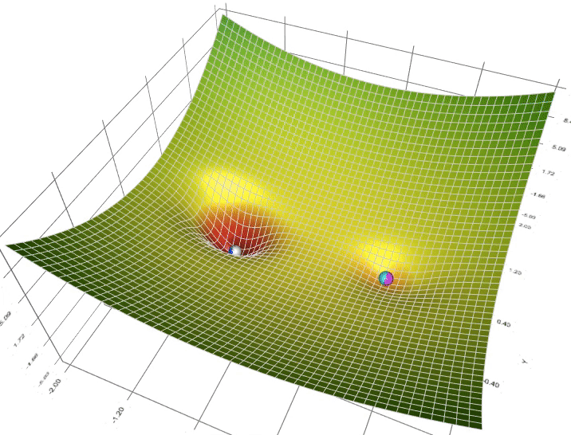
Perceptron: Differentiation?
Notes:
Imagine you’re on a hill and you want to get to the bottom. But, it’s really foggy and you can’t see the bottom. So, what do you do? You might feel the ground with your feet to figure out which way is downhill and start walking in that direction.
This is similar to what we’re doing with gradient descent. The “hill” is our error: we want to reduce it, or get it to the “bottom”. The “fog” is because we don’t know ahead of time what the best weights are to minimize the error.
So, we calculate the gradient, which tells us the direction of steepest ascent - or which way is “uphill”.
But we want to go downhill, so we go in the opposite direction - we subtract the gradient from our weights.
We take small steps (determined by a parameter called the learning rate) to ensure we don’t overshoot the bottom. We keep doing this until we get to the bottom of the hill, or in other words, until our error is as small as we can get it.
Don’t take LARGE steps or you’ll be running around with no real progress.
CONS: getting stuck in local minima!!!!

Slide 30
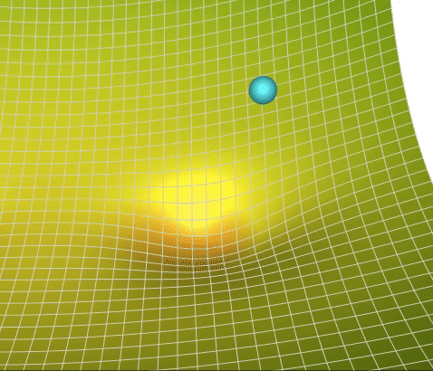
Perceptron: Differentiation?
Notes:
Imagine you’re on a hill and you want to get to the bottom. But, it’s really foggy and you can’t see the bottom. So, what do you do? You might feel the ground with your feet to figure out which way is downhill and start walking in that direction.
This is similar to what we’re doing with gradient descent. The “hill” is our error: we want to reduce it, or get it to the “bottom”. The “fog” is because we don’t know ahead of time what the best weights are to minimize the error.
So, we calculate the gradient, which tells us the direction of steepest ascent - or which way is “uphill”.
But we want to go downhill, so we go in the opposite direction - we subtract the gradient from our weights.
We take small steps (determined by a parameter called the learning rate) to ensure we don’t overshoot the bottom. We keep doing this until we get to the bottom of the hill, or in other words, until our error is as small as we can get it.
Don’t take LARGE steps or you’ll be running around with no real progress.
CONS: getting stuck in local minima!!!!
VIDEO

Slide 31
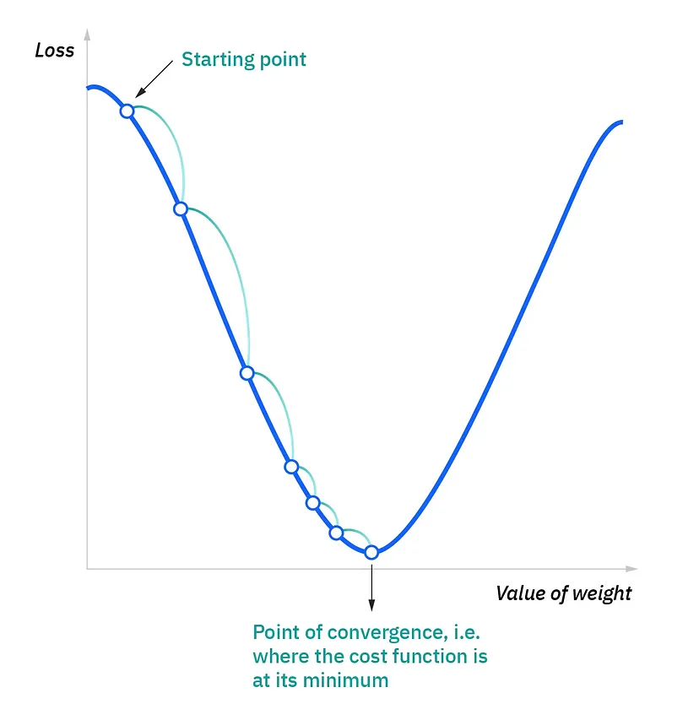
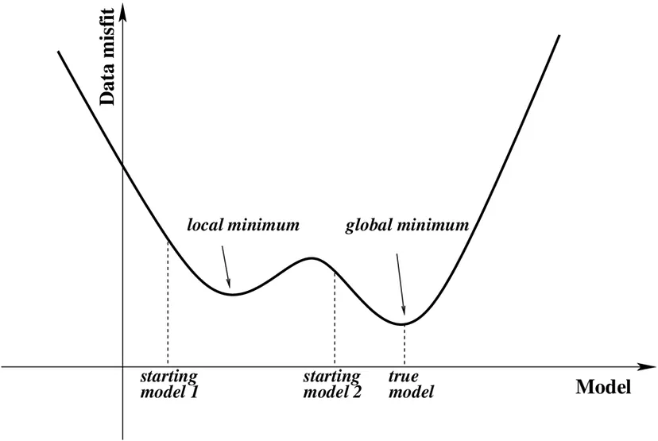
Perceptron: Differentiation?
Notes:
Imagine you’re on a hill and you want to get to the bottom. But, it’s really foggy and you can’t see the bottom. So, what do you do? You might feel the ground with your feet to figure out which way is downhill and start walking in that direction.
This is similar to what we’re doing with gradient descent. The “hill” is our error: we want to reduce it, or get it to the “bottom”. The “fog” is because we don’t know ahead of time what the best weights are to minimize the error.
So, we calculate the gradient, which tells us the direction of steepest ascent - or which way is “uphill”.
But we want to go downhill, so we go in the opposite direction - we subtract the gradient from our weights.
We take small steps (determined by a parameter called the learning rate) to ensure we don’t overshoot the bottom. We keep doing this until we get to the bottom of the hill, or in other words, until our error is as small as we can get it.
Don’t take LARGE steps or you’ll be running around with no real progress.
CONS: getting stuck in local minima!!!!

Slide 32
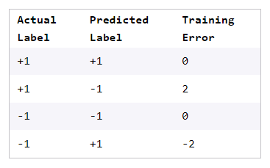
Perceptron Training Error
Training error is the measure of how accurate a perceptron classification is for a specific training data sample. It essentially measures “how bad” the perceptron is performing and helps determine what adjustments need to be made to the weights of that sample to increase classification accuracy.
Training error = actual label − predicted label
*obviously
Notes:
It’s like saying I want it to give me binary values/ clean definite answers- I need a line on a plane, that cleanly separates it for the same.
One of these special functions is applied to the weighted sum of inputs and weights to constrain perceptron output to a value in a certain range, depending on the problem.
Some example ranges are [0,1], [-1,1], [0,100].

Slide 33
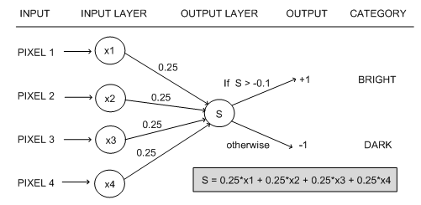
Perceptron: Goodbye Habibi
Notes:
It’s like saying I want it to give me binary values/ clean definite answers- I need a line on a plane, that cleanly separates it for the same.
One of these special functions is applied to the weighted sum of inputs and weights to constrain perceptron output to a value in a certain range, depending on the problem.
Some example ranges are [0,1], [-1,1], [0,100].
Multi-layer Perceptrons
Step-by-step Python Implementation

Slide 34
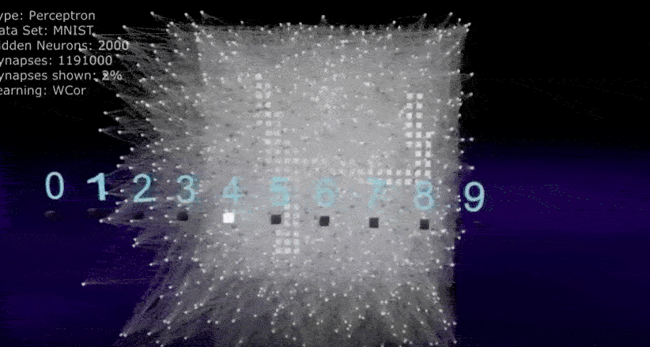
Notes:
I know we keep bringing classification problems into every kind of algorithm, but you need to understand most algorithm differ in accuracy, architecture and size of dataset they can handle, and NOT the problems they solve.

Slide 35
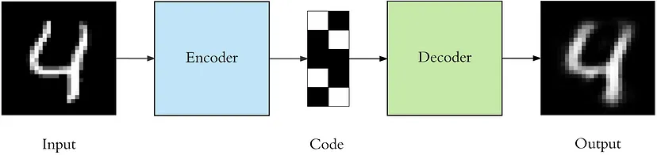
Autoencoders
An autoencoder is a type of neural network architecture designed to efficiently compress (encode) input data down to its essential features, then reconstruct (decode) the original input from this compressed representation.
Here’s a simple breakdown of how autoencoders work:
Encoding: The input data is compressed into a lower-dimensional code by the encoder. This code is a representation that retains the essential features of the input data.
Decoding: The decoder then attempts to reconstruct the original input data from this encoded representation. The goal is to minimize the difference between the original input and the reconstruction.
Notes:
Specifically, we'll design a neural network architecture such that we impose a bottleneck in the network which forces a compressed knowledge representation of the original input. If the input features were each independent of one another, this compression and subsequent reconstruction would be a very difficult task. However, if some sort of structure exists in the data (ie. correlations between input features), this structure can be learned and consequently leveraged when forcing the input through the network's bottleneck.
Autoencoders are used for various applications, including dimensionality reduction, anomaly detection, and generative models. They can also be used to learn representations for subsequent classification tasks.
Autoencoders refer to a specific subset of encoder-decoder architectures that are trained via unsupervised learning to reconstruct their own input data.

Slide 36
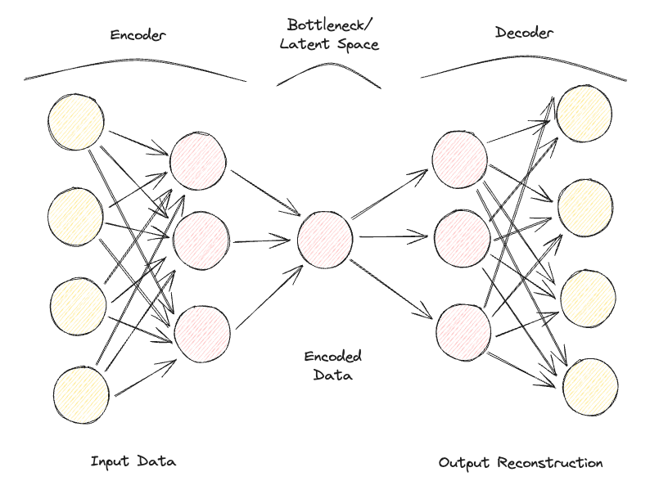
Autoencoders
Notes:
The bottleneck is a key attribute of our network design; without the presence of an information bottleneck, our network could easily learn to simply memorize the input values by passing these values along through the network.
A fundamental goal of the design and training of an autoencoder is discovering the minimum number of important features (or dimensions) needed for effective reconstruction of the input data.
A bottleneck constrains the amount of information that can traverse the full network, forcing a learned compression of the input data.
Note: If we were to construct a linear network (ie. without the use of nonlinear activation functions at each layer) we would observe a similar dimensionality reduction as observed in PCA. Geoffrey Hinton's discussion of this here.
This trade-off forces the model to maintain only the variations in the data required to reconstruct the input without holding on to redundancies within the input.
—
CONs:
Data-specific: Autoencoders are only able to meaningfully compress data similar to what they have been trained on. Since they learn features specific for the given training data, they are different than a standard data compression algorithm like gzip. So we can’t expect an autoencoder trained on handwritten digits to compress landscape photos.
Lossy: The output of the autoencoder will not be exactly the same as the input, it will be a close but degraded representation. If you want lossless compression they are not the way to go.

Slide 37
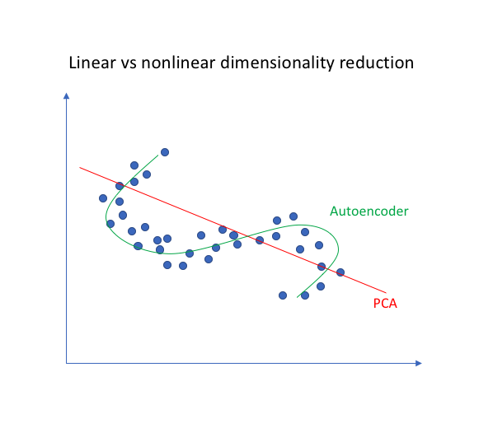
Autoencoders
Notes:
More reading
DL Book: Autoencoders
Because they do not rely on labeled training data, autoencoders are not considered a supervised learning method. Like all unsupervised learning methods, autoencoders are trained to discover hidden patterns in unlabeled data, rather than to predict known patterns demonstrated in labeled training data; however, like supervised learning models—and unlike most examples of unsupervised learning—autoencoders have a ground truth to measure their output against: the original input itself (or some modified version of it). For that reason, they are considered “self-supervised learning”–hence, autoencoder.

Slide 38
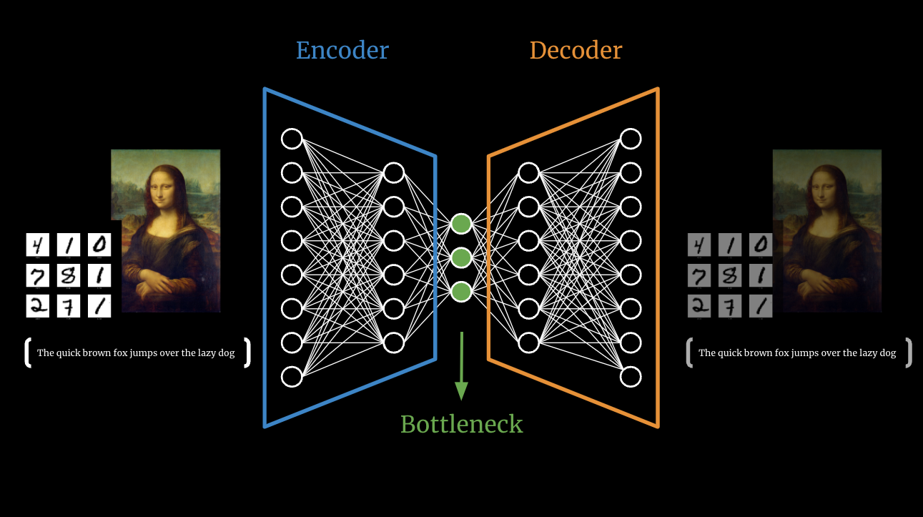
Autoencoders: Types
Over the years, different types of Autoencoders have been developed:
Undercomplete Autoencoder
Sparse Autoencoder
Denoising Autoencoder
Convolutional Autoencoder

Slide 39
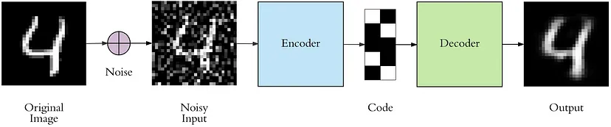
Autoencoders: Denoising

Slide 40
Autoencoders: Regularization
We can take an unlabeled dataset and frame it as a supervised learning problem tasked with outputting a reconstruction of the original input This network can be trained by minimizing the reconstruction error, which measures the differences between our original input and the consequent reconstruction.
The bottleneck is a key attribute of our network design; without the presence of an information bottleneck, our network could easily learn to simply memorize the input values by passing these values along through the network
For most cases, this involves constructing a loss function where one term encourages our model to be sensitive to the inputs (ie. reconstruction loss) and a second term discourages memorization/overfitting (ie. an added regularizer).
Loss function = Reconstruction + Regularizer
Notes:
Regularized autoencoders: add regularization term that encourages the model to have other properties
• Sparsity of the representation (sparse autoencoder)
• Robustness to noise or to missing inputs (denoising autoencoder)
• Smallness of the derivative of the representation

Slide 41
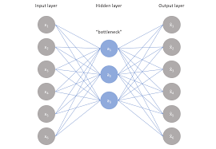
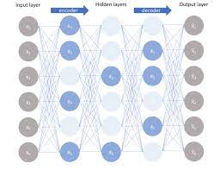
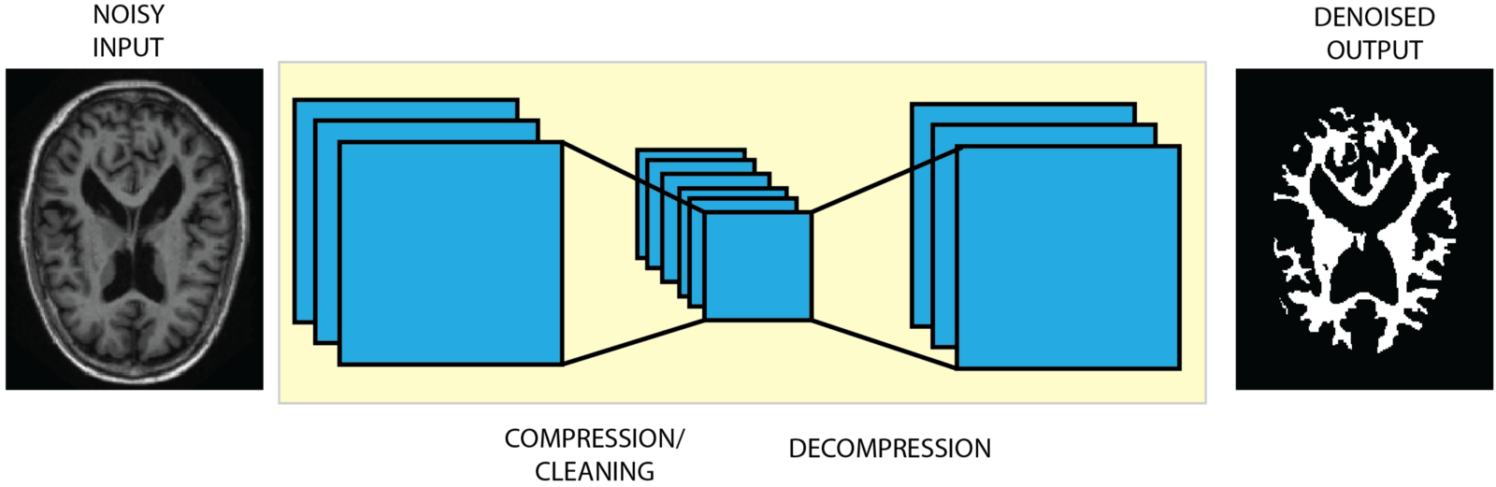
Non-regularized
Undercomplete
Regularized
Sparse Autoencoder
Denoising Autoencoder

Slide 42
Regularized
Sparse Autoencoder
We don’t necessarily have to reduce the dimensions of the bottleneck, but we use a loss function that tries to penalize the model from using all its neurons in the different hidden layers.
This penalty is commonly referred to as a sparsity function, and it's quite different from traditional regularization techniques since it doesn’t focus on penalizing the size of the weights but the number of nodes activated.
In this way, different nodes could specialize for different input types and be activated/deactivated depending on the specifics of the input data.
Notes:
we allow our network to sensitize individual hidden layer nodes toward specific attributes of the input data.
Sparse autoencoders are typically used to learn features for another task, such
as classiﬁcation. An autoencoder that has been regularized to be sparse must
respond to unique statistical features of the dataset it has been trained on, rather
than simply acting as an identity function. In this way, training to perform the
copying task wit

Slide 43
Regularized
Denoising Autoencoder
With Denoising Autoencoders, the input and output of the model are no longer the same. For example, the model could be fed some low-resolution corrupted images and work for the output to improve the quality of the images.
We'll construct our loss function such that we penalize activations within a layer. For any given observation, we'll encourage our network to learn an encoding and decoding which only relies on activating a small number of neurons. It's worth noting that this is a different approach towards regularization, as we normally regularize the weights of a network, not the activations.
In order to assess the performance of the model and improve it over time, we would then need to have some form of labeled clean image to compare with the model prediction.
Notes:
Rather, the model learns a vector field for mapping the input data towards a lower-dimensional manifold (recall from my earlier graphic that a manifold describes the high density region where the input data concentrates); if this manifold accurately describes the natural data, we've effectively "canceled out" the added noise.

Slide 44
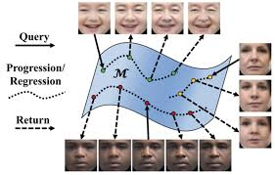
Regularized
Denoising Autoencoder: Manifolds
Notes:
Rather, the model learns a vector field for mapping the input data towards a lower-dimensional manifold (recall from my earlier graphic that a manifold describes the high density region where the input data concentrates); if this manifold accurately describes the natural data, we've effectively "canceled out" the added noise.
A very important property of DAEs is that their training criterion (with
conditionally Gaussian makes the autoencoder learn a vector ﬁeld that estimates the score of the data distribution

Slide 45
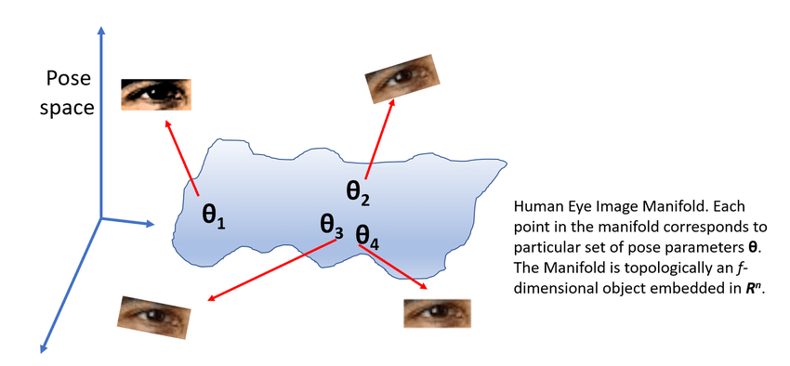
Notes:
Rather, the model learns a vector field for mapping the input data towards a lower-dimensional manifold (recall from my earlier graphic that a manifold describes the high density region where the input data concentrates); if this manifold accurately describes the natural data, we've effectively "canceled out" the added noise.
A very important property of DAEs is that their training criterion (with
conditionally Gaussian makes the autoencoder learn a vector ﬁeld that estimates the score of the data distribution

Slide 46
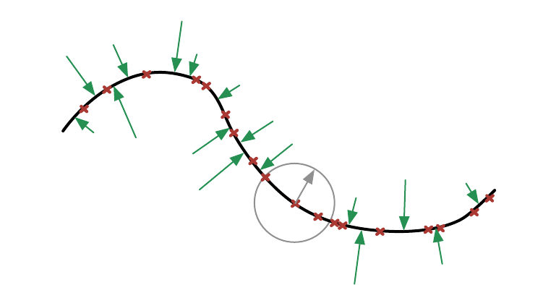
Notes:
Rather, the model learns a vector field for mapping the input data towards a lower-dimensional manifold (recall from my earlier graphic that a manifold describes the high density region where the input data concentrates); if this manifold accurately describes the natural data, we've effectively "canceled out" the added noise.
A very important property of DAEs is that their training criterion (with
conditionally Gaussian makes the autoencoder learn a vector ﬁeld that estimates the score of the data distribution

Slide 47
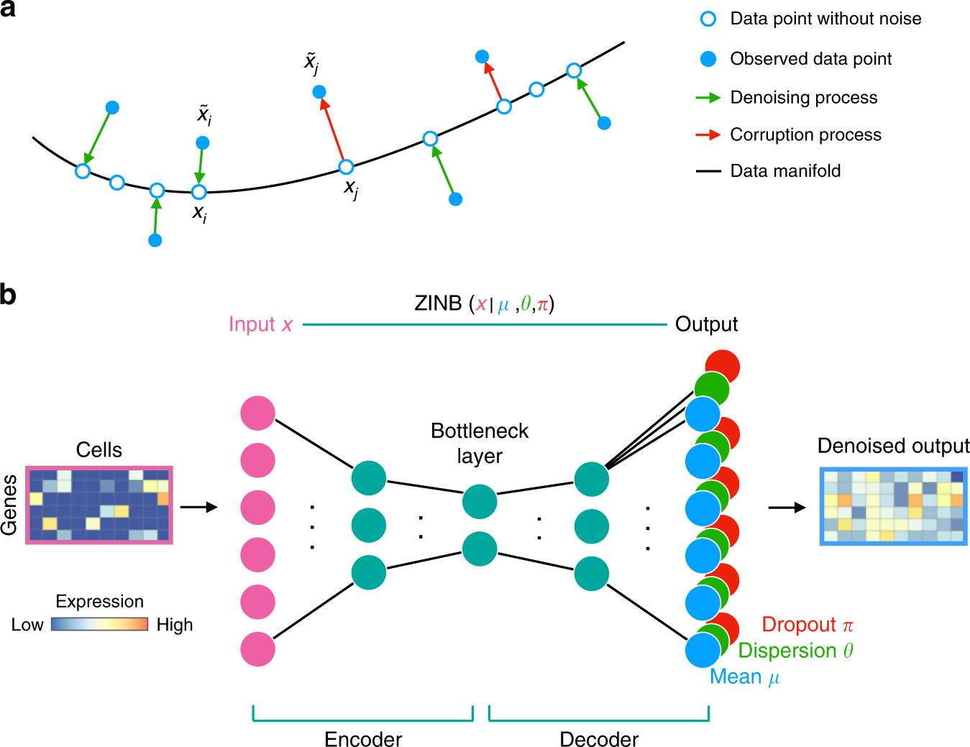
Notes:
Rather, the model learns a vector field for mapping the input data towards a lower-dimensional manifold (recall from my earlier graphic that a manifold describes the high density region where the input data concentrates); if this manifold accurately describes the natural data, we've effectively "canceled out" the added noise.
A very important property of DAEs is that their training criterion (with
conditionally Gaussian makes the autoencoder learn a vector ﬁeld that estimates the score of the data distribution

